Slide 1

Lenka

Slide 2
Warm up
List three adjectives that you wish described you – share with your partners.
Why did you choose those words?

Slide 3
Warm up
Now associate those characteristic with a personan animal or thing…
Example: smart, happy, cool
I wish I was as smart as Einstein.
I wish I was as happy as a clam.
I wish I was as cool as a rock star.

Slide 4
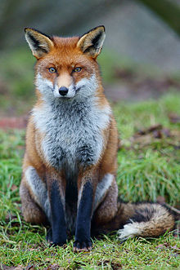
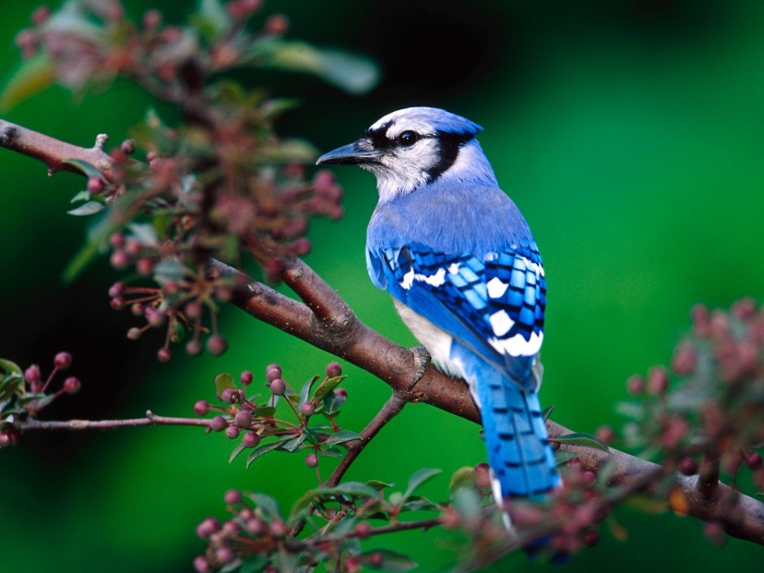
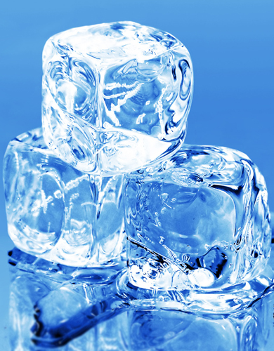
What’s the expression?
As….

Slide 5


What’s the expression?
As…

Slide 6
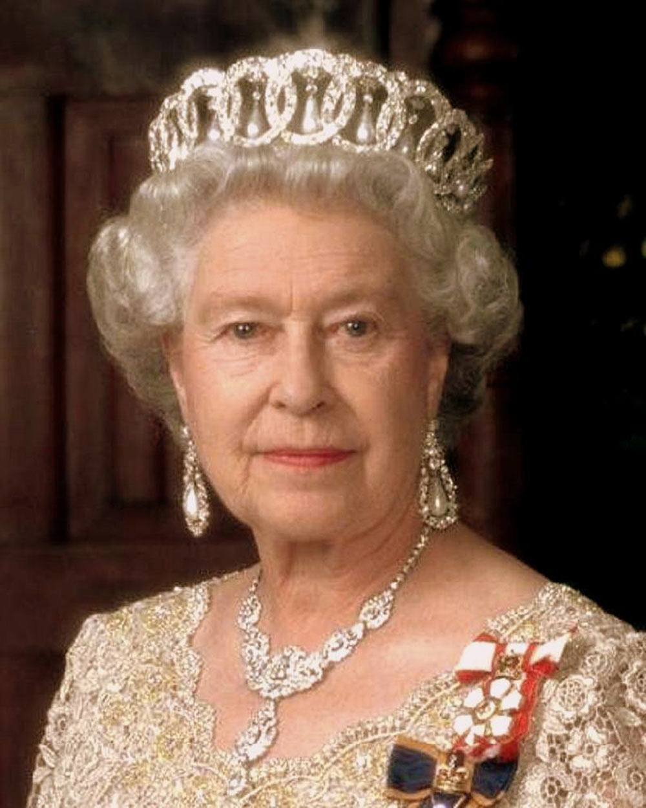

What’s the expression?
As…

Slide 7
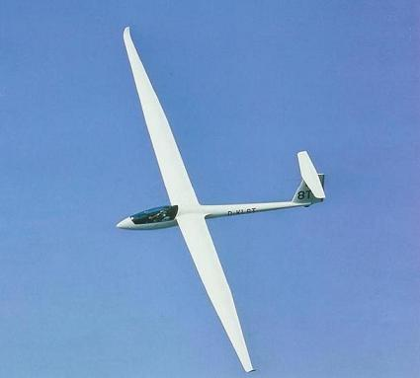

What’s the expression?
As…

Slide 8

What’s the expression?
As…

Slide 9
Lyrics preview
With your partner.
Look at the lyrics and guess the missing words.

Slide 10
Listen and check
As sly as a fox, as strong as an ox
As fast as a hare, as brave as a bear
As free as a bird, as neat as a word
As quiet as a mouse, as big as a house
All I wanna be, all I wanna be, oh
All I wanna be is everything

Slide 11
Listen and check
As mean as a wolf, as sharp as a tooth
As deep as a bite, as dark as the night
As sweet as a song, as right as a wrong
As long as a road, as ugly as a toad
As pretty as a picture hanging from a fixture
Strong like a family, strong as I wanna be
Bright as day, as light as play
As hard as nails, as grand as a whale

Slide 12
Listen and check
As warm as the sun, as silly as fun
As cool as a tree, as scary as the sea
As hot as fire, cold as ice
Sweet as sugar and everything nice
As old as time, as straight as a line
As royal as a queen, as buzzed as a bee
As stealth as a tiger, smooth as a glider
Pure as a melody, pure as I wanna be

Slide 13
Listen and check
All I wanna be oh, all I wanna be, oh
All I wanna be is everything
Everything at once

Slide 14
Analysis
What do these expression mean?
as right as wrong
as buzzed as a bee
as hard as nails
as cool as a tree
as straight as a line
Why do you think the singer wants to be as ugly as a toad? Would you?

Slide 15
Discussion
Have you heard this song before?
Windows 8 advertising
Why did Microsoft choose this song for its advertising?

